Slide 1
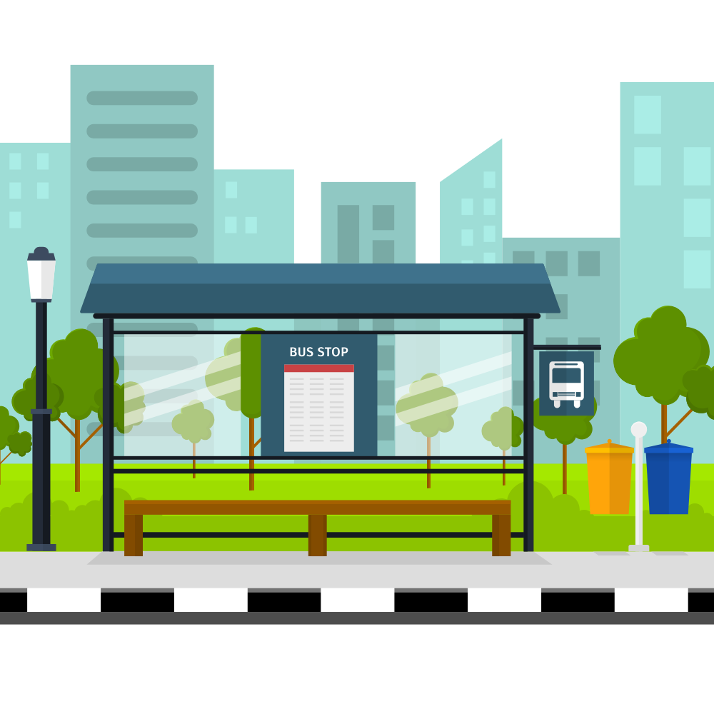

e-Conductor
Group 09
(Next Level of Sri Lankan Public Transport)
Department of Computer Engineering
Faculty of Engineering
University of Peradeniya
Sri Lanka
Notes:
Good morning all of you.
We are grp #9
We propose to build an online ticket booking app for public transport buses.
E conductor

Slide 2
e-Conductor
Group 09
(Next Level of Sri Lankan Public Transport)
Department of Computer Engineering
Faculty of Engineering
University of Peradeniya
Sri Lanka
Notes:
It will be the next level of Sri Lankan Public Transport
Let’s start our journey.

Slide 3



OUR TEAM
THE PROBLEM
EXISTING SOLUTIONS ?
OUR SOLUTION
OUR PLAN
e-Conductor
Notes:
As you can see these are the main stops of our journey
First, I would like to introduce our team.

Slide 4


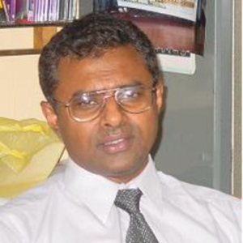
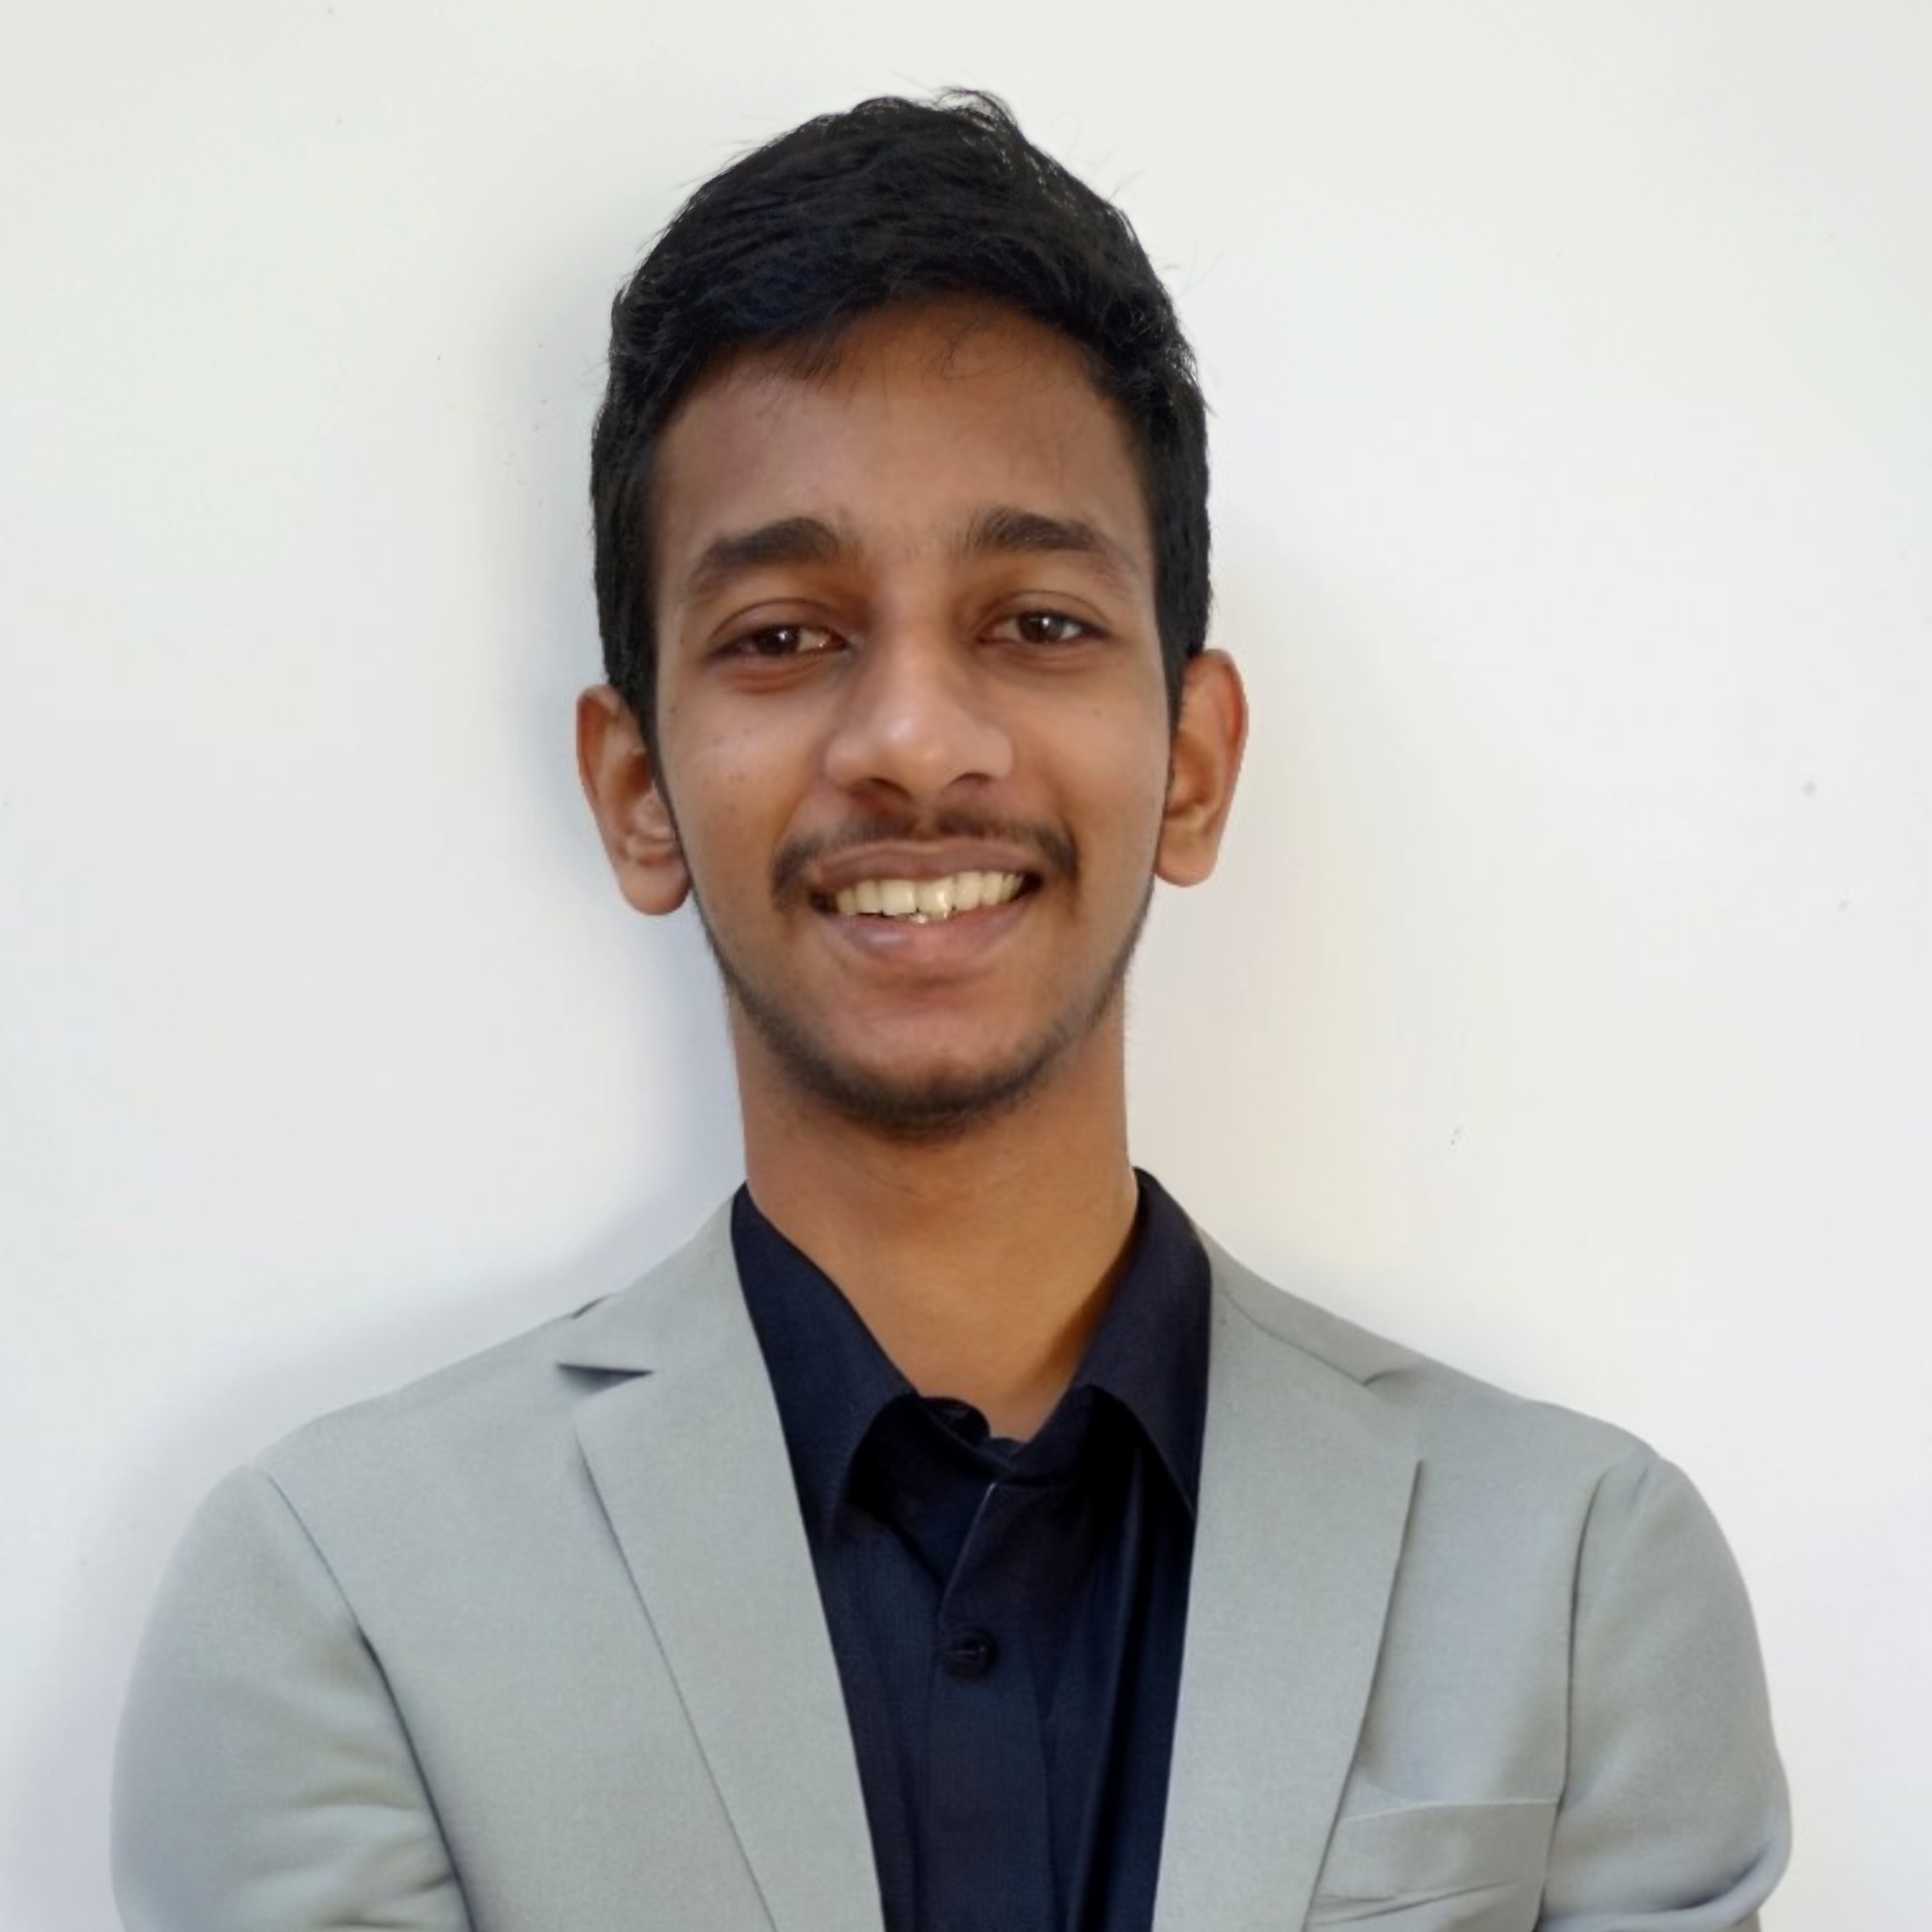
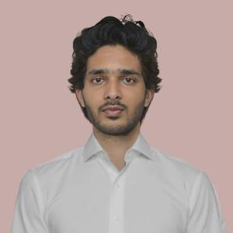
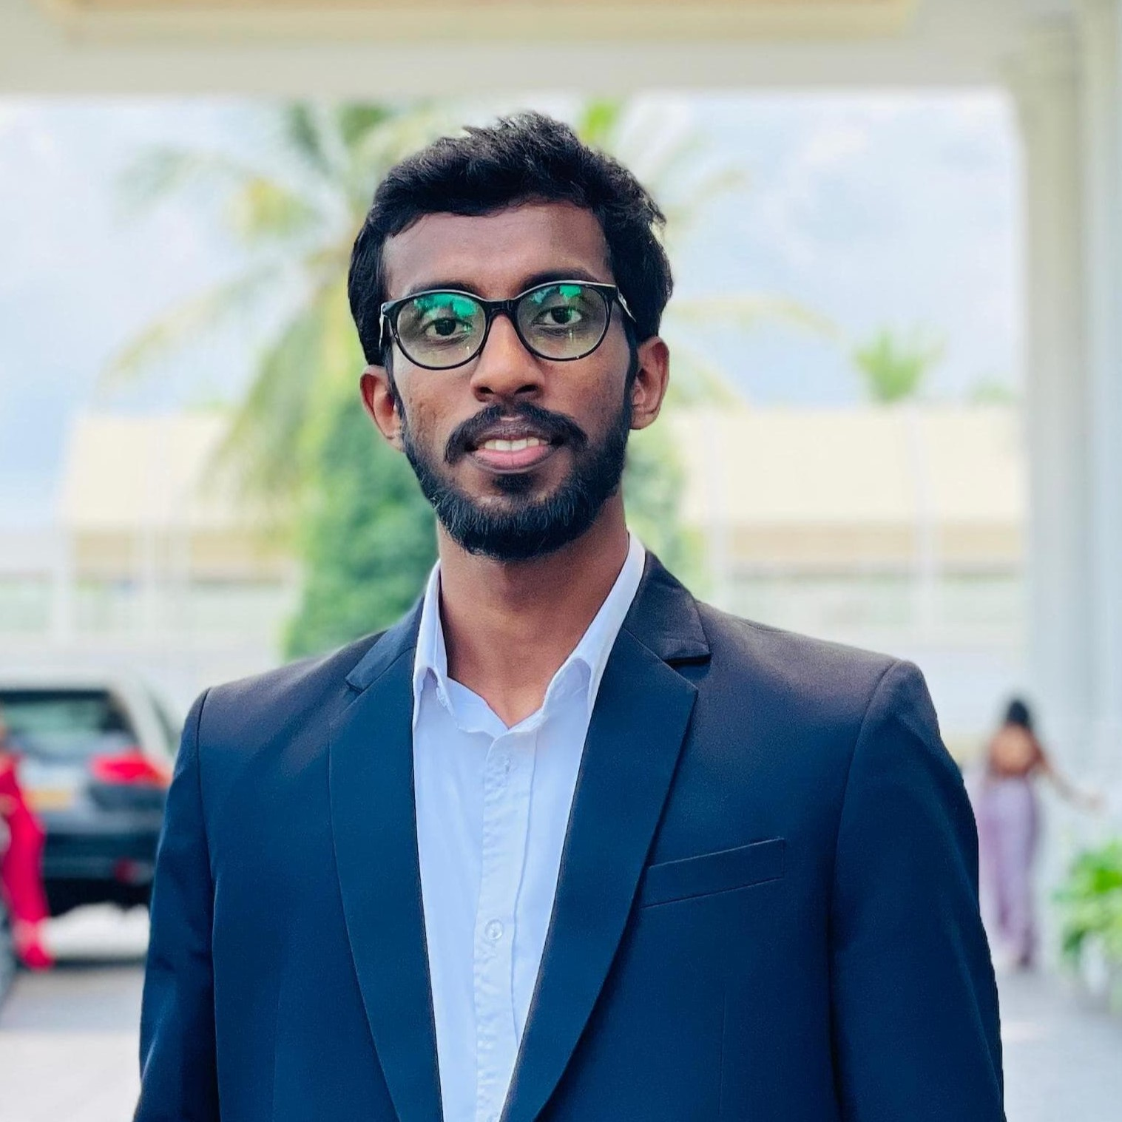
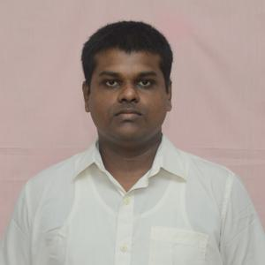
OUR TEAM
SUPERVISOR
Prof. Manjula Sandirigama
E/20/032
Bandara A.M.N.C.
E/20/035
Bandara K.C.H.N.A.W.M.R.C.J.N.
E/20/133 Haththella H.A.D.T.N.
E/20/157
Janakantha S.M.B.G.
Notes:
Our supervisor is Prof. Mangula Sandirigama
Team members are:
Chethiya
Chamuidtha
Tharusha
And my self.

Slide 5
OUR TEAM
THE PROBLEM
EXISTING SOLUTIONS ?
OUR SOLUTION
OUR PLAN
e-Conductor
Notes:
Now we come to our next stop.
The problem

Slide 6
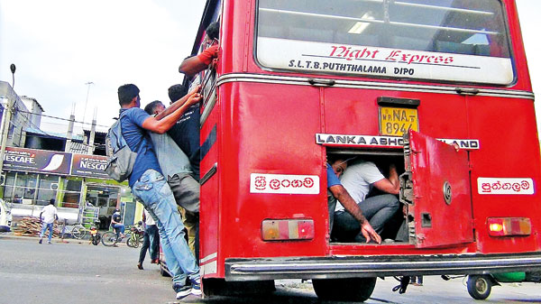
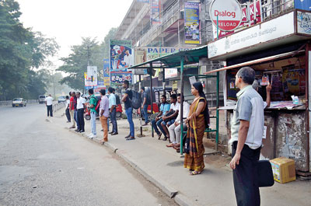
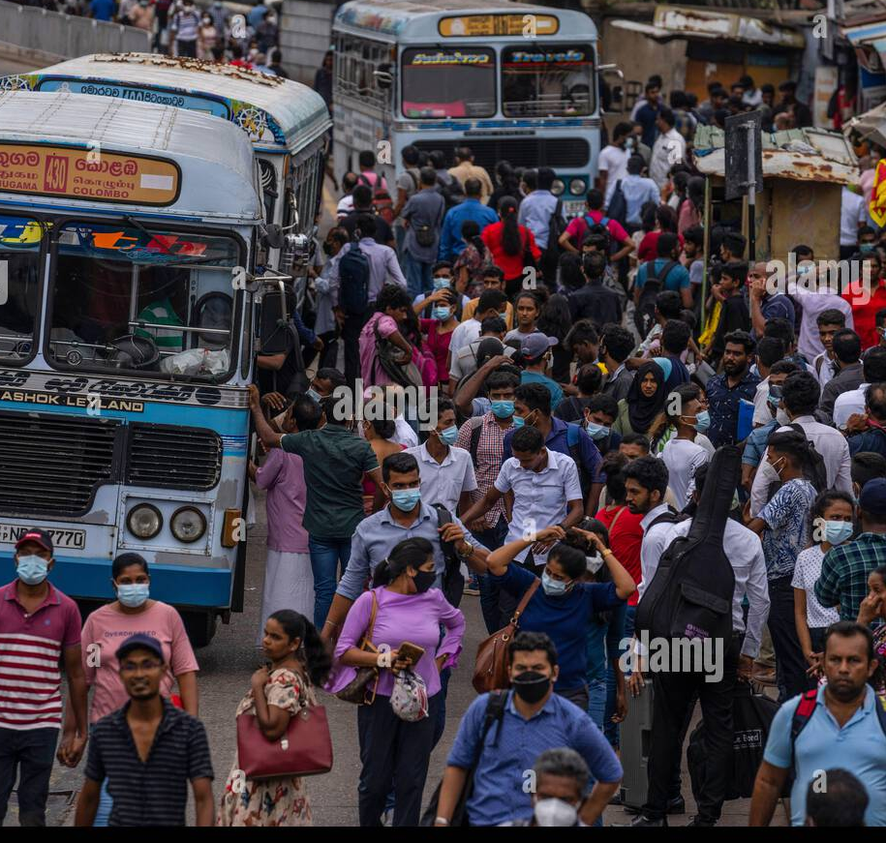

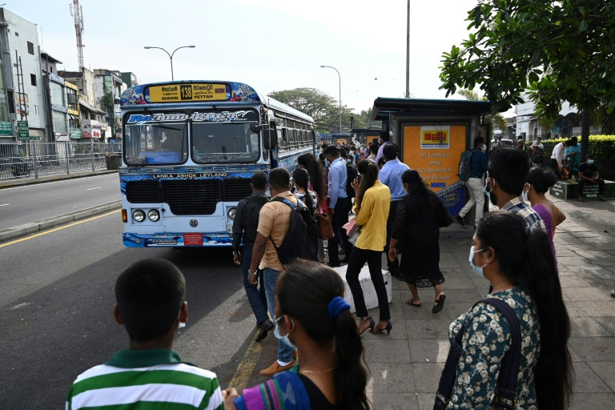


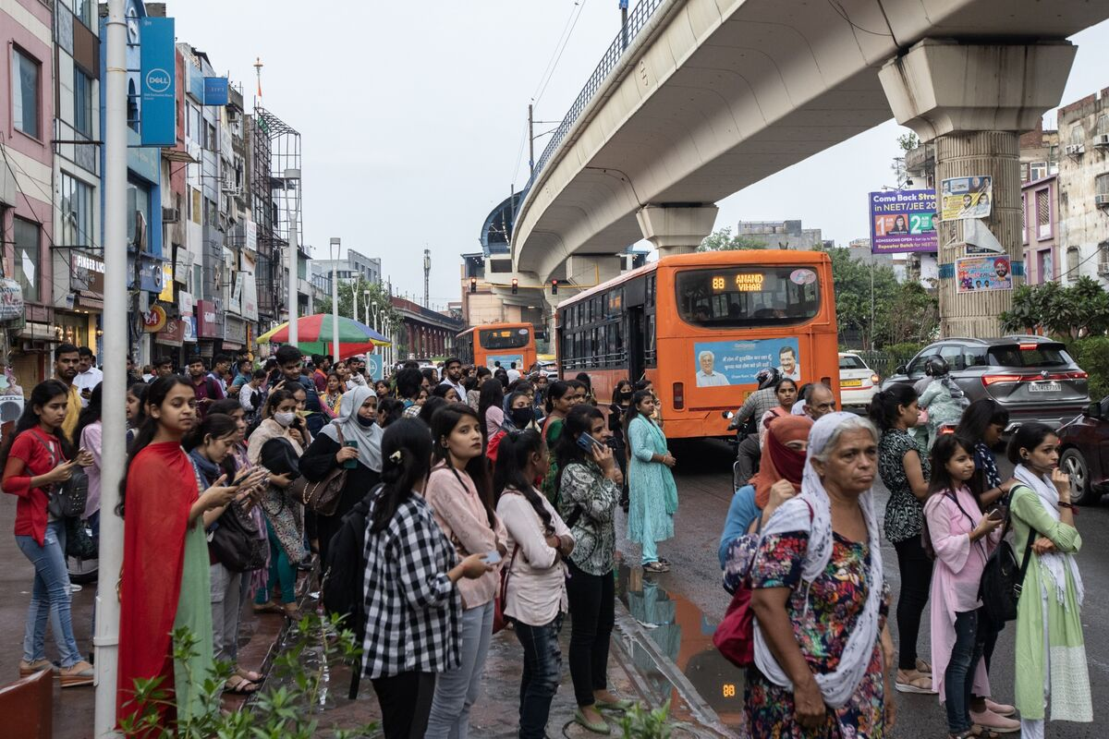

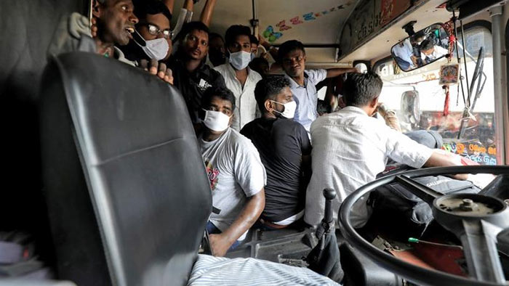

THE PROBLEM
Waiting in long queues
No method to find availability of busses
Overcrowded busses
Issues on getting balance
Shifting from public transport
Notes:
Did you use public transport? How about the feeling?
Due to the current situation of the public transport,
We need to wait in long queues. It is very time-consuming.
Also no method for checking the availability of buses.
Due to the unavailability of a bus, most probably the next bus will be overcrowded. Did you feel that feeling before?
The next issue in public transport is Getting improper balance. Sometimes most people argue with the conductor for this reason.
Because of these issues in our community there is a negative image on public transport. So many people are getting away from public transport.

Slide 7
OUR TEAM
THE PROBLEM
EXISTING SOLUTIONS ?
OUR SOLUTION
OUR PLAN
e-Conductor
Notes:
Over to you Chethiya

Slide 8
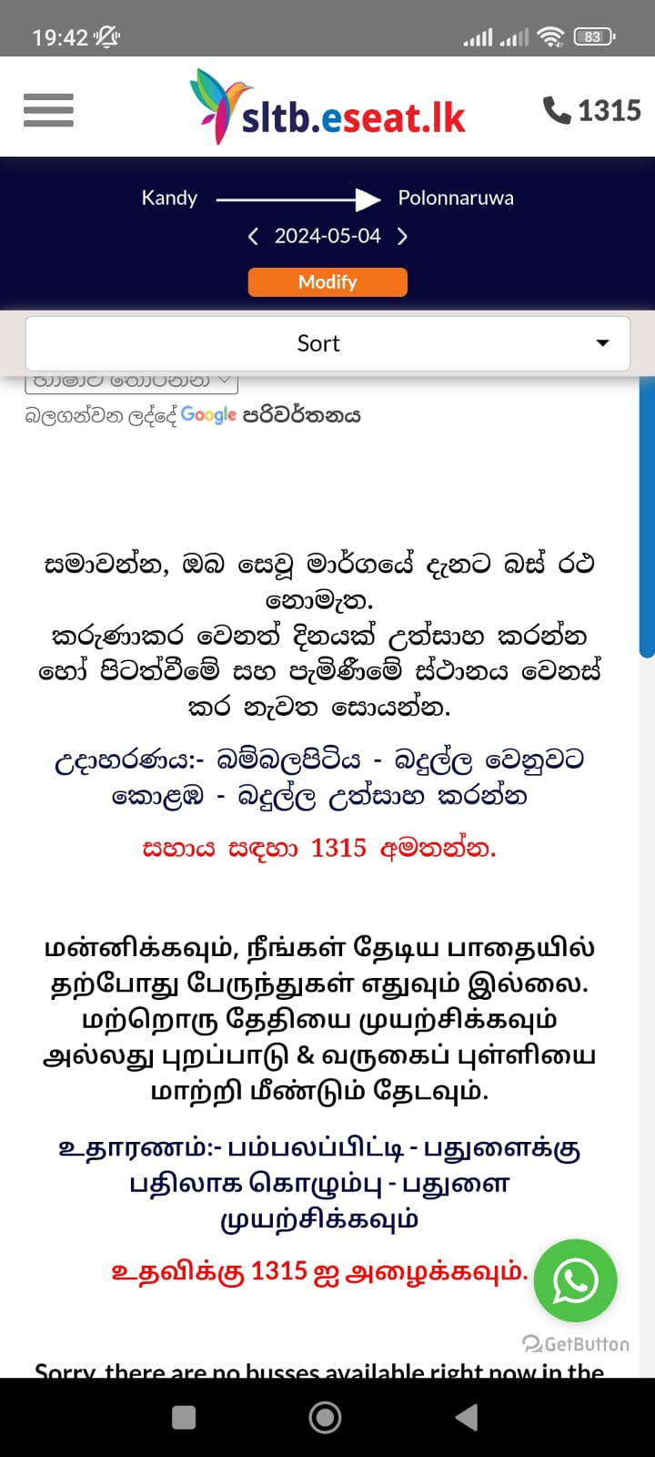
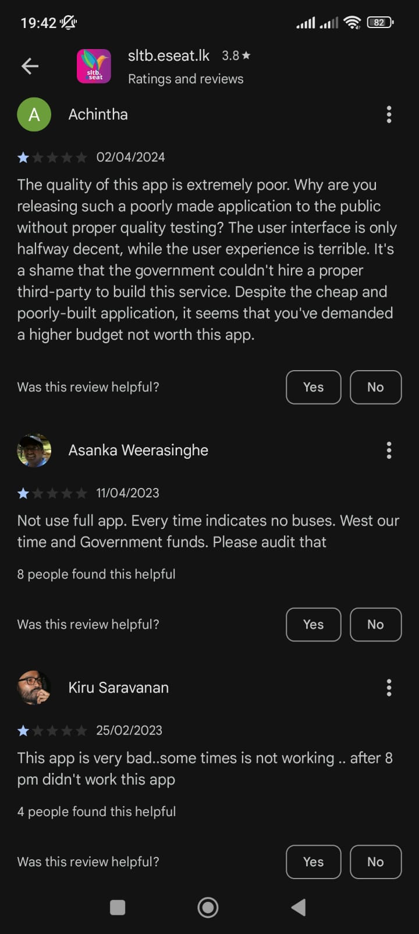

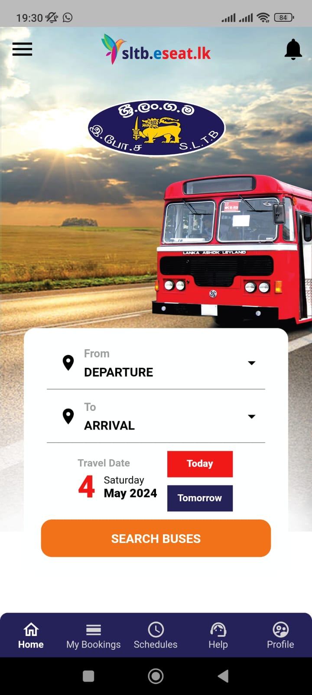

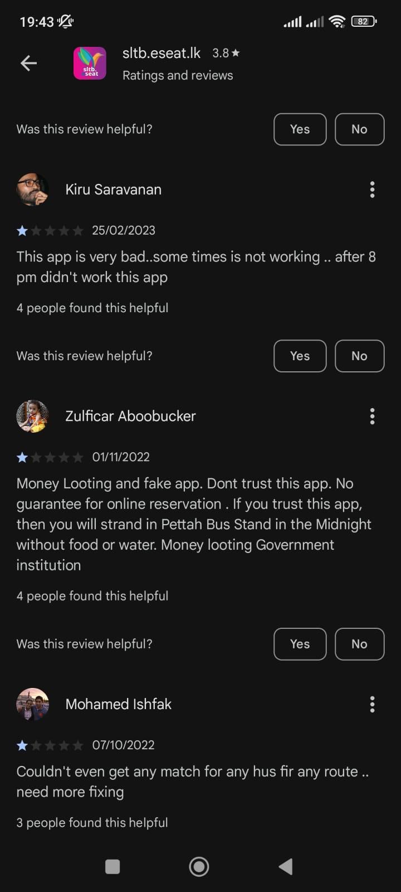


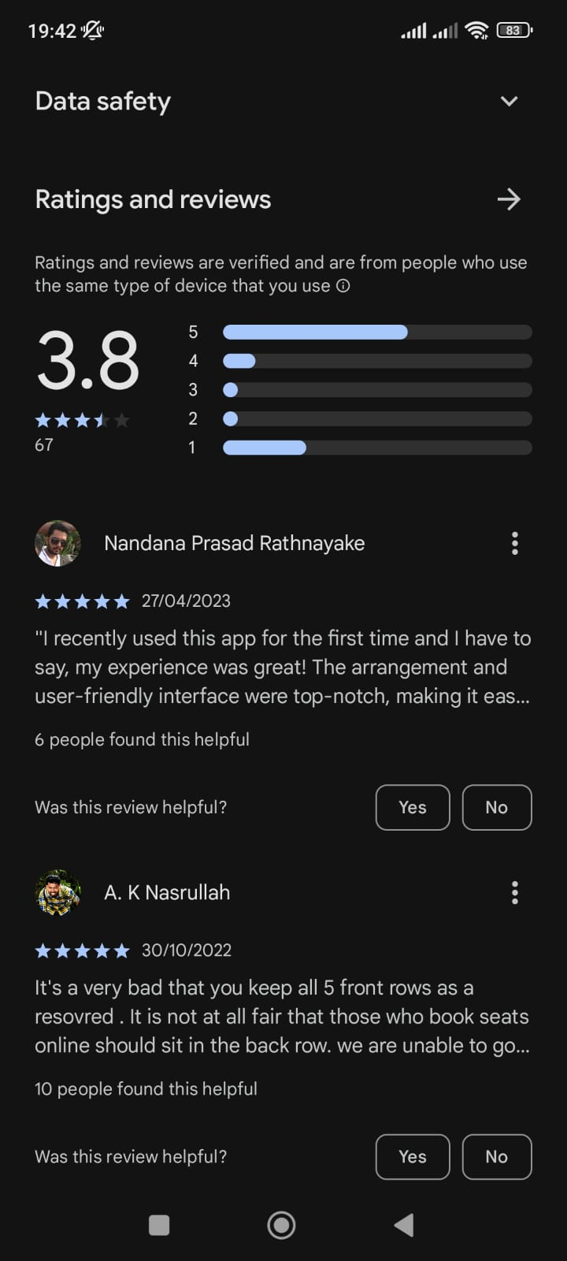

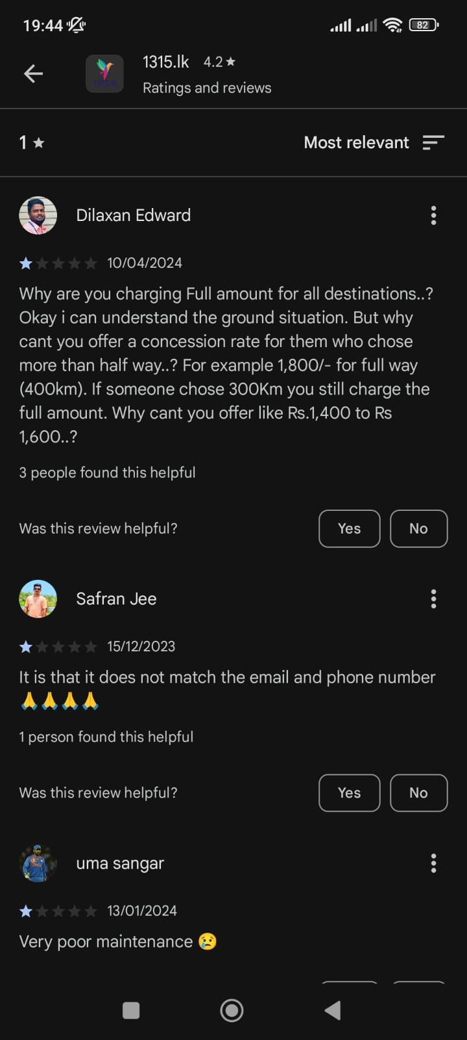

EXISTING SOLUTIONS ?
No method for tracking busses
Payment and booking are not guaranteed
Contact details are not available
Schedules are outdated
No Methods for complaints

Slide 9
OUR TEAM
THE PROBLEM
EXISTING SOLUTIONS ?
OUR SOLUTION
OUR PLAN
e-Conductor

Slide 10





OUR SOLUTION
Online seat reservation facility
Online schedule checking facility
Realtime location tracking facility
Digital transaction facility
Customer care service

Slide 11
OUR TEAM
THE PROBLEM
EXISTING SOLUTIONS ?
OUR SOLUTION
OUR PLAN
e-Conductor

Slide 12







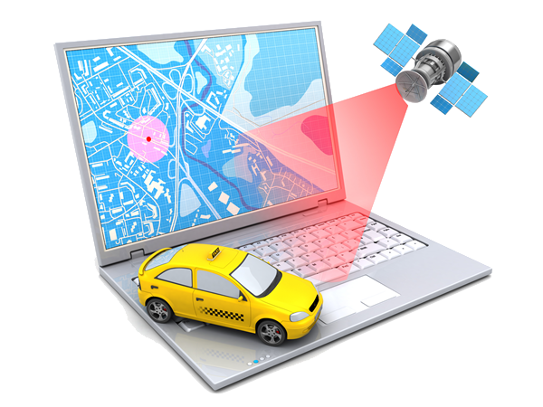
OUR PLAN
Web App
Mobile App
Database
Testing & Debugging
Payment Gateway
App Launching
Suggestion Algorithm
Live Location Tracking
Notes:
Further implementation: Extend to normal routes, Merge train App

Slide 13
OUR TEAM
THE PROBLEM
EXISTING SOLUTIONS ?
OUR SOLUTION
OUR PLAN
e-Conductor

Slide 14
THANK YOU

